Slide 1
BIRDS-5
Transceiver Sensitivity: Cable Test
26-July-2021
Ramson Nyamukondiwa
Edgar Mujuni

Slide 2
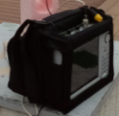
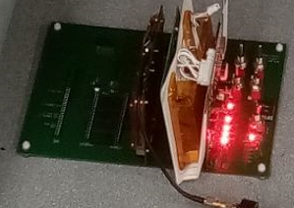
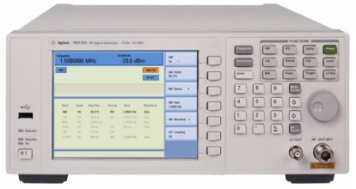
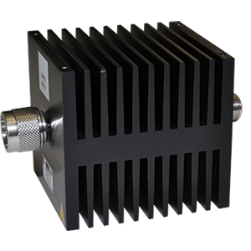



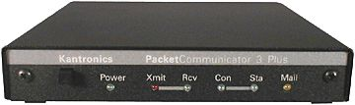
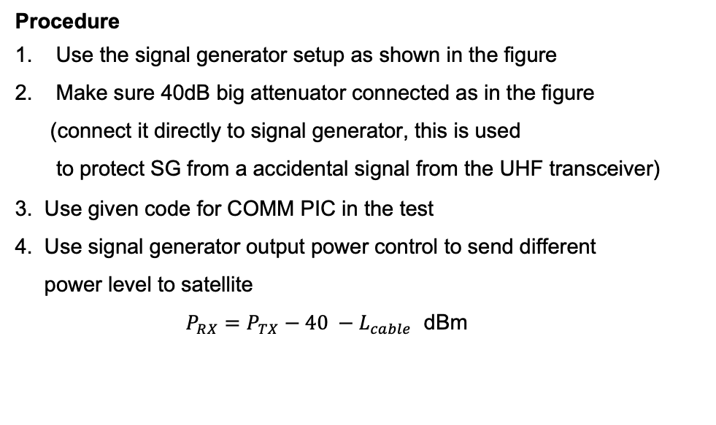

Test Setup
Signal generator
Testbed in Shield Box
Or
40dB ATT
UHF dipole
Serial Reader
TNC
To TRX RF cable
From COMM PIC UART

Slide 3
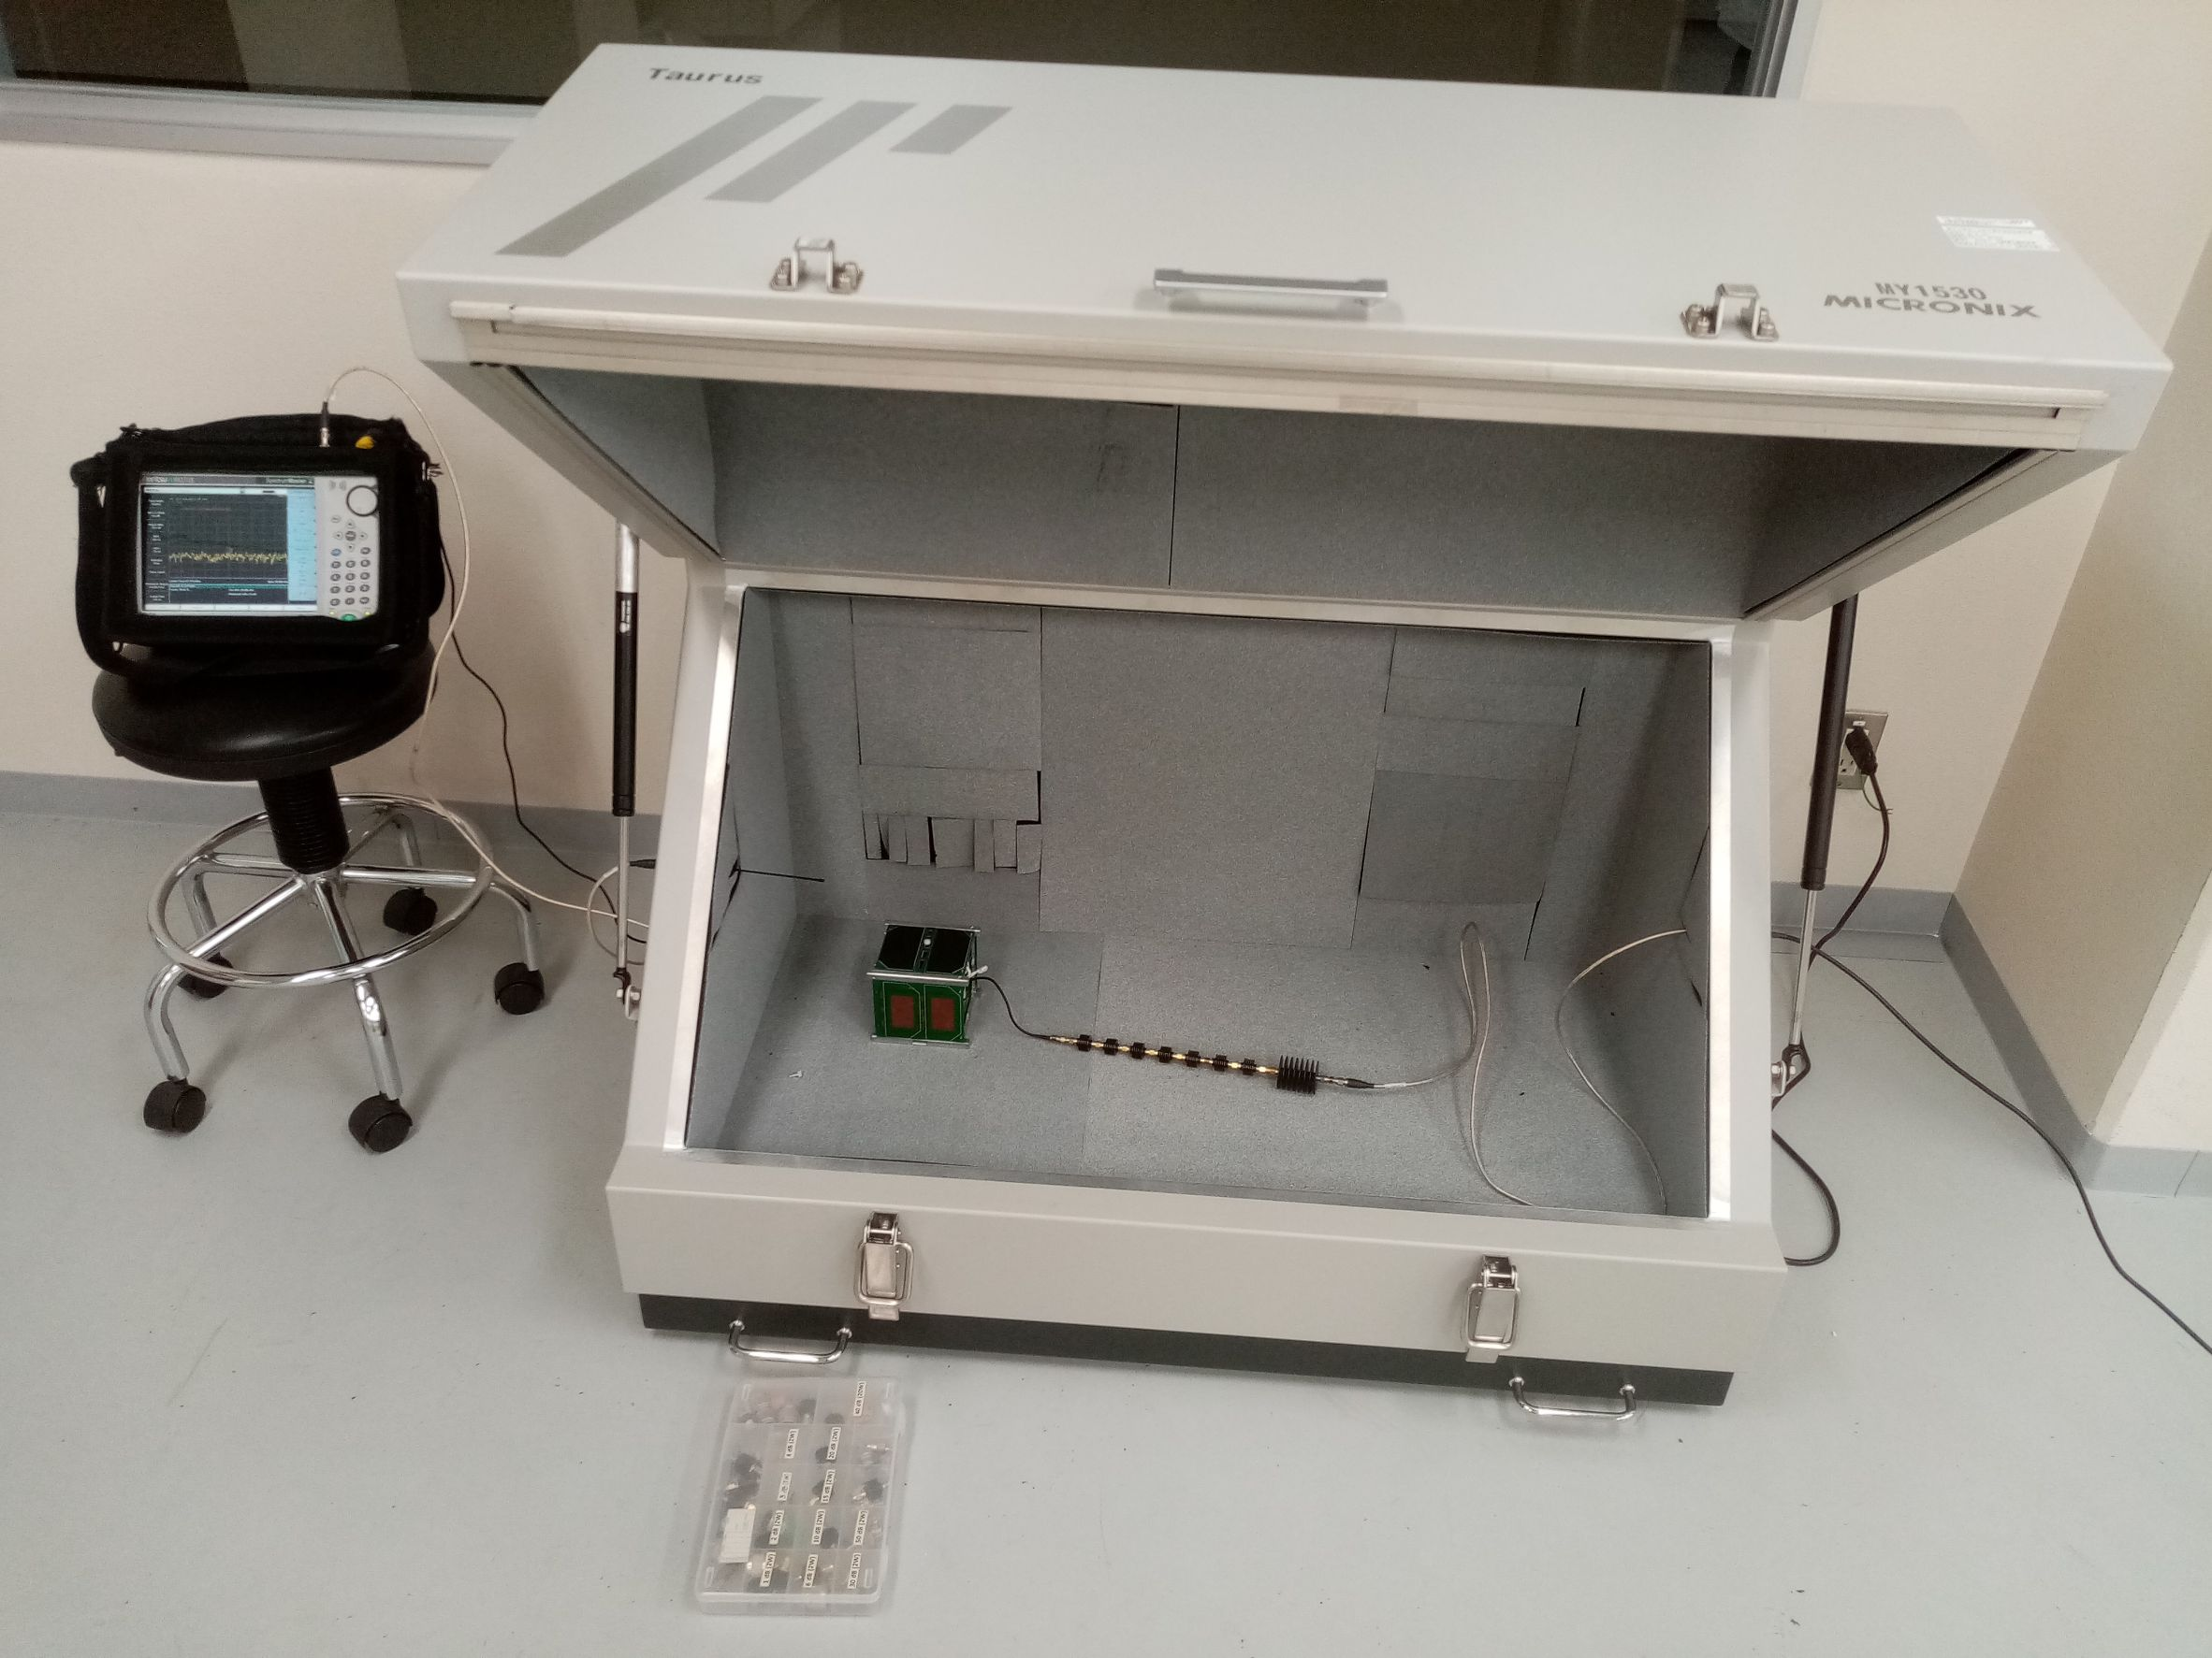
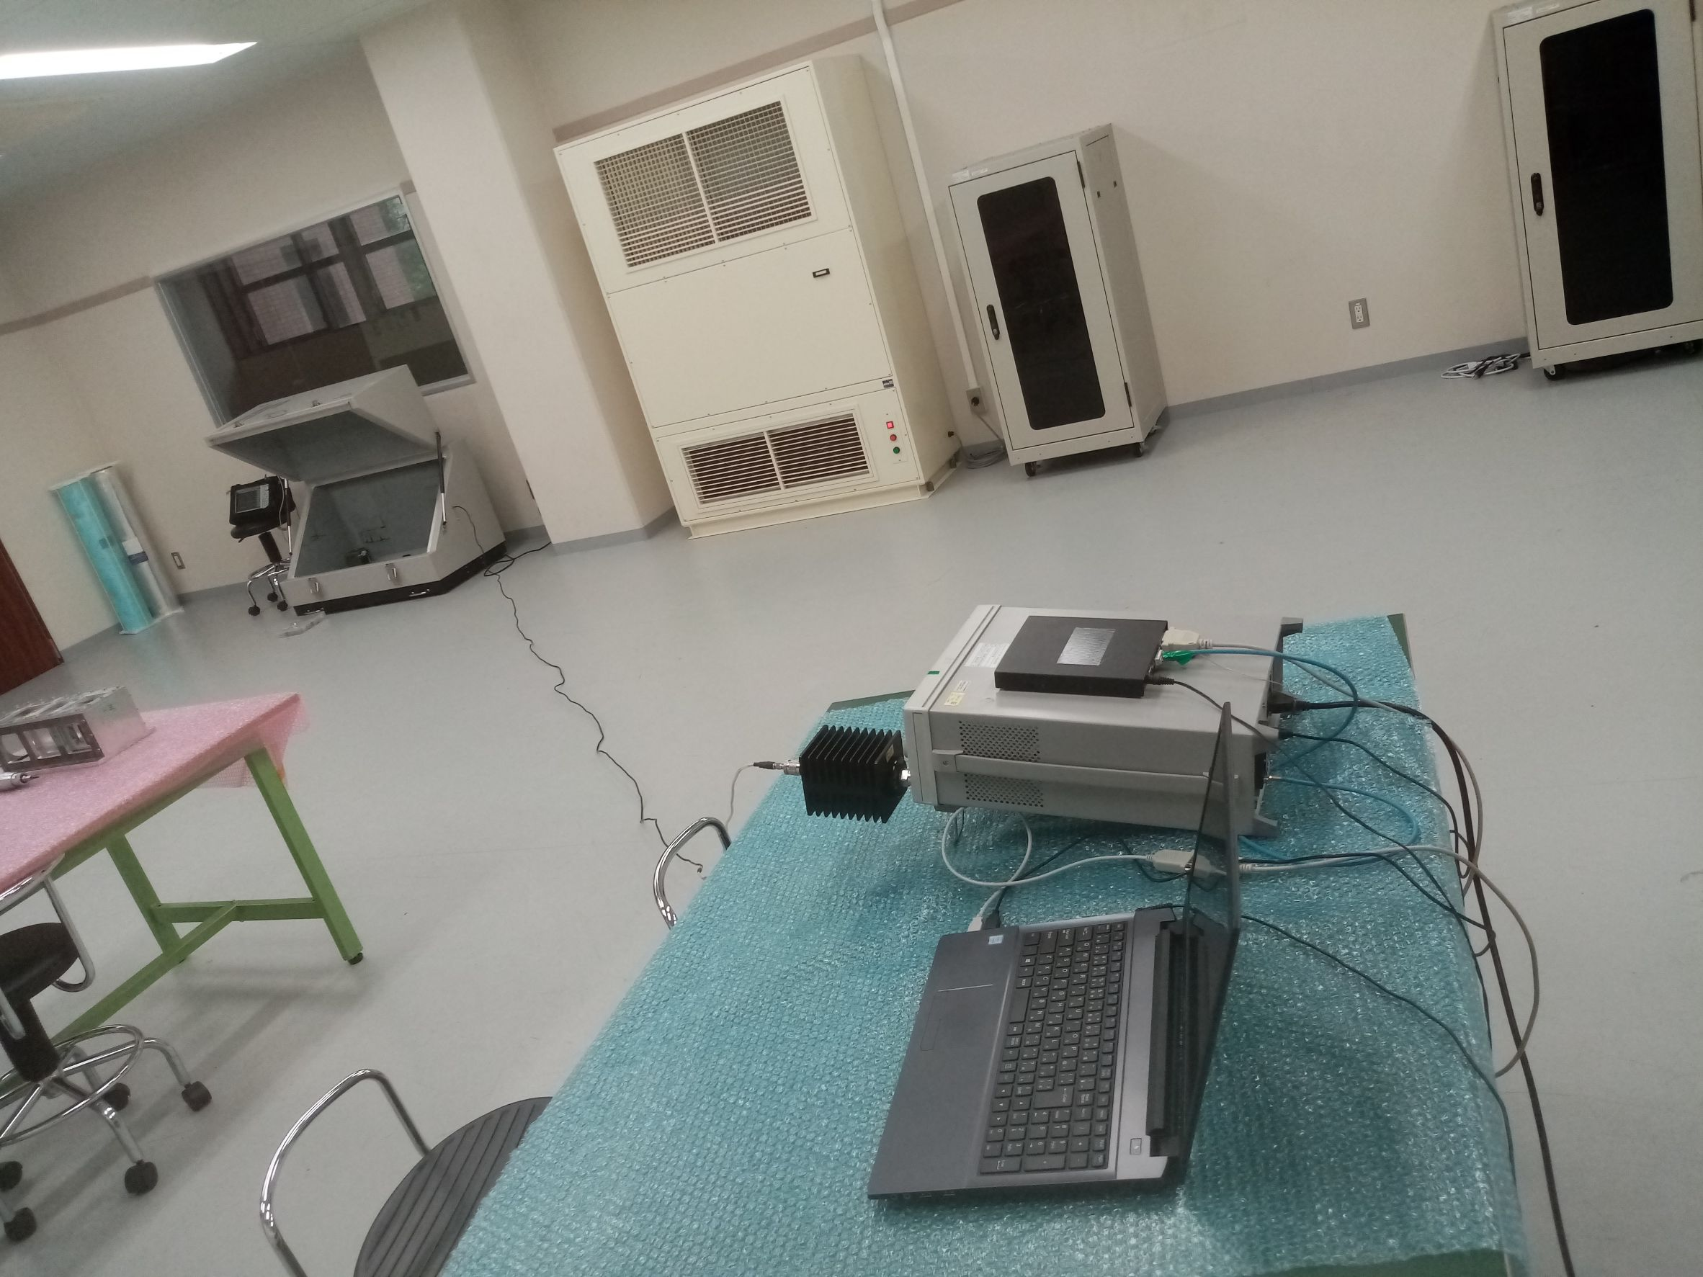
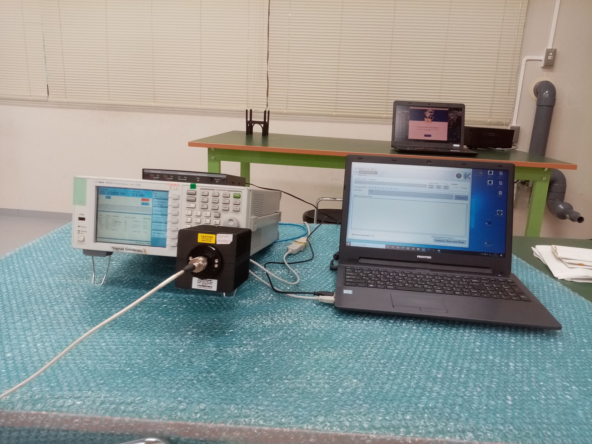
Actual Lab Setup
Shield Box Settings
Overall Settings
Spectrum Analyser
Attenuators
Satellite
GS setting
TNC
SG
GS laptop
39dB Attenuator

Slide 4
Results TRX A (BIRDS-3)
Transmitted power from SG (dBm) | Total Attenuation (dB) (Attenuators+L_cable) | Received power to the UHF TRX A P_RX=P_TX-Total Attenuators (dBm) | Success Rate
0 | 98 | -98 | 6/6
0 | 104 | -104 | 6/6
0 | 108 | -108 | 6/6
0 | 110 | -110 | 6/6
0 | 112 | -112 | 6/6
0 | 113 | -113 | 6/6
0 | 114 | -114 | 6/6
0 | 115 | -115 | 2/6
0 | 116 | -116 | 0/6
UHF Transceiver Sensitivity: -114 dBm

Slide 5
Results TRX B (SaganSat)
Transmitted power from SG (dBm) | Total Attenuation (dB) (Attenuators+L_cable) | Received power to the UHF TRX B P_RX=P_TX-Total Attenuators (dBm) | Success Rate
0 | -103.5 | -103.5 | 6/6
0 | -109.5 | -109.5 | 6/6
0 | -113.5 | -113.5 | 6/6
0 | -114.5 | -114.5 | 8/10
0 | -115.5 | -115.5 | 4/10
0 | -116.5 | -116.5 | 0
UHF Transceiver Sensitivity: -114 dBm
Sensitivity of TRX A and TRX B is the same

Slide 6
Comparison of BIRDS Cable Test Results
BIRDS Satellite | RSSI (dBm)
BIRDS 2S | -114
BIRDS 3 | -114
BIRDS 4 | -114
BIRDS 5 | -114
Conclusion:
BIRDS 2S, BIRDS 3, BIRDS 4 and BIRDS 5 same RSSI

